Slide 1
DASA DevOps
Ivan Cipriani

Slide 2
Agenda
Introducing DASA DevOps Fundamentals
Building the DevOps Context
Knowing DevOps for Individuals
Getting acquainted with DevOps culture and behavior
Understanding the value of DevOps for team and organizations
Getting familiar with DevOps management practices
Getting familiar with DevOps technical practices
Enabling DevOps team performance through continuous delivery and automation

Slide 3

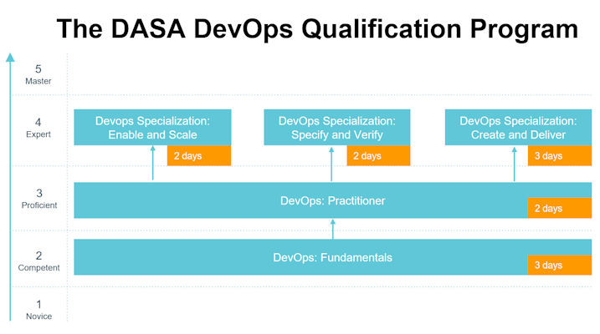
Introducing DASA DevOps Fundamentals

Slide 4
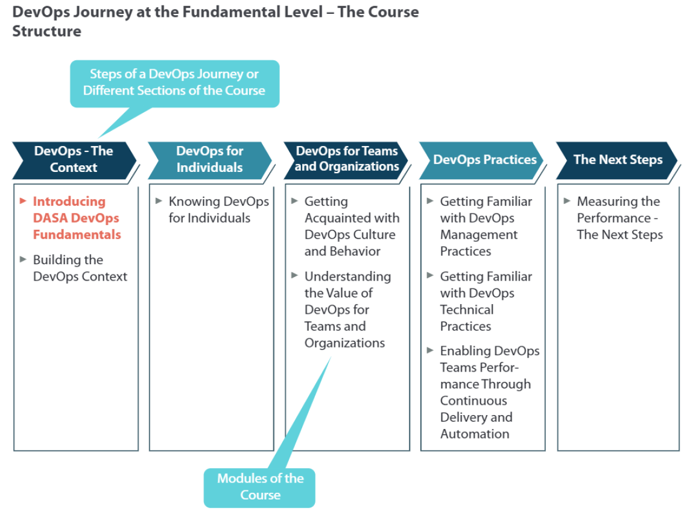
Introducing DASA DevOps Fundamentals

Slide 5
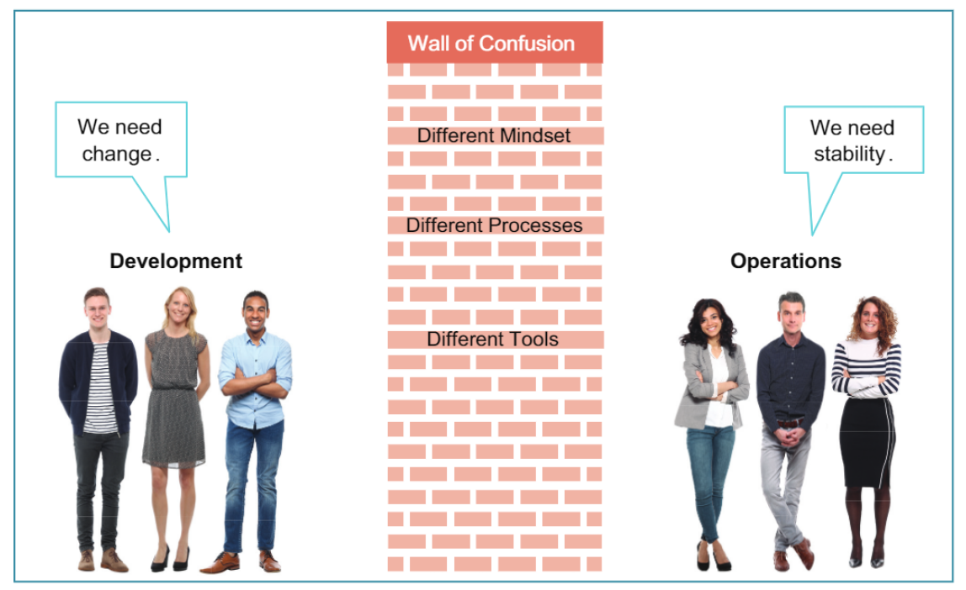
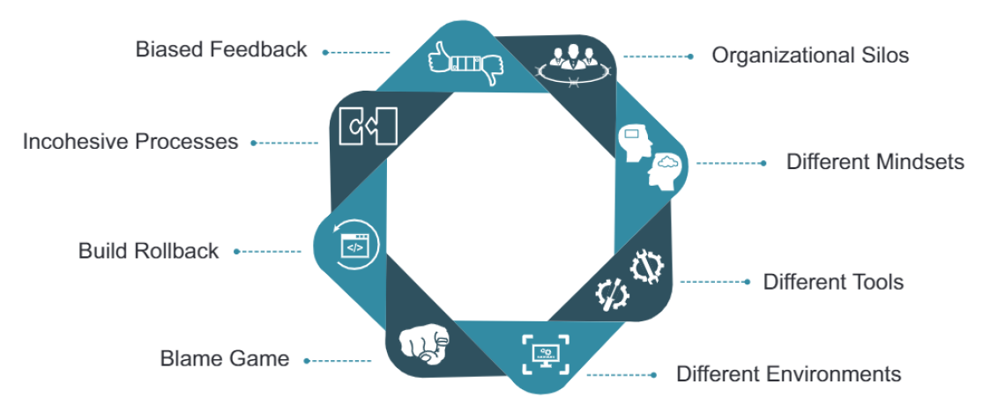
Building the DevOps Context

Slide 6
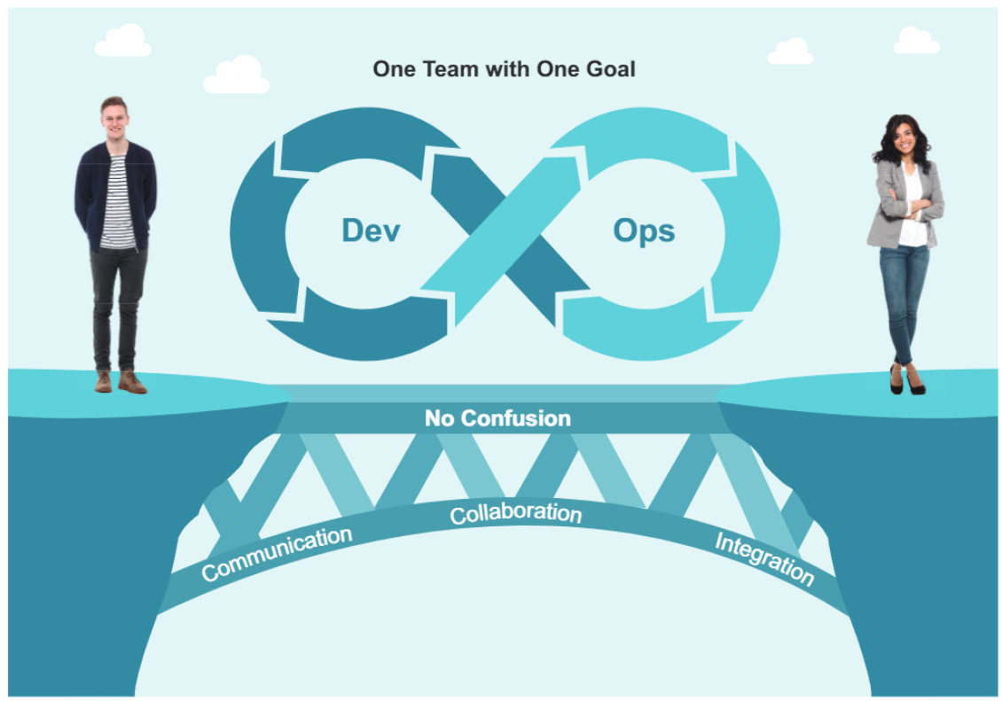
Building the DevOps Context

Slide 7
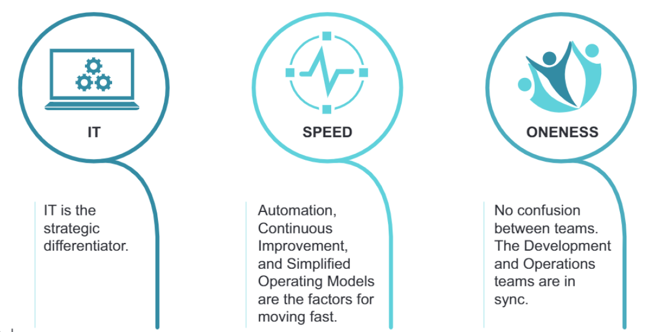
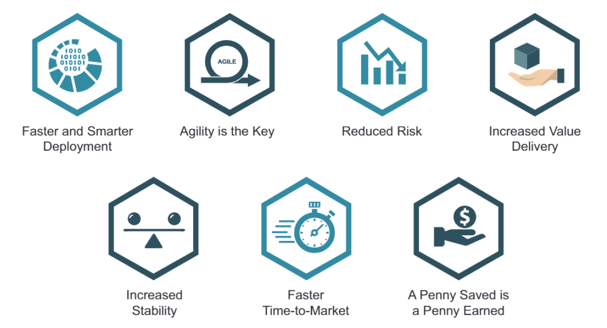
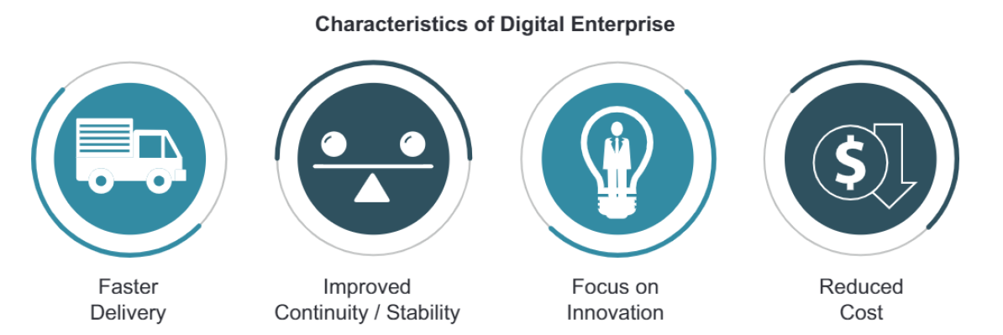
Building the DevOps Context

Slide 8
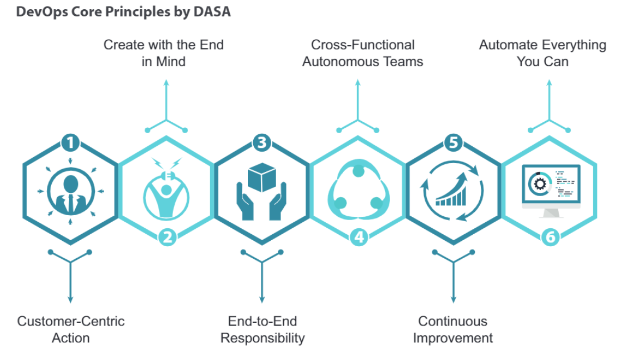
Building the DevOps Context

Slide 9
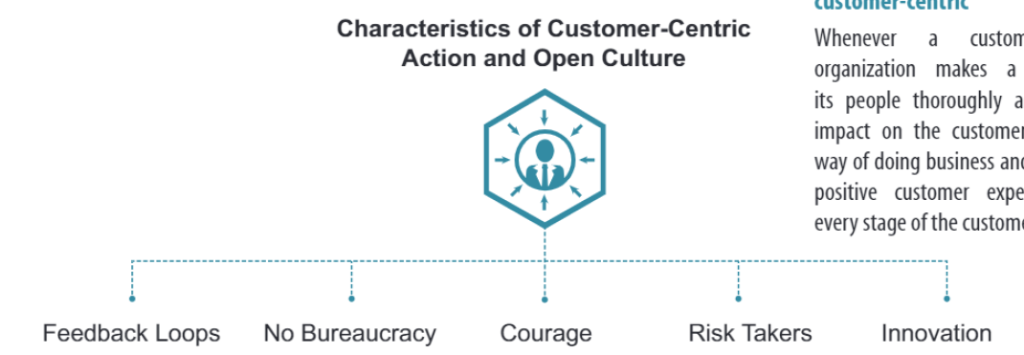
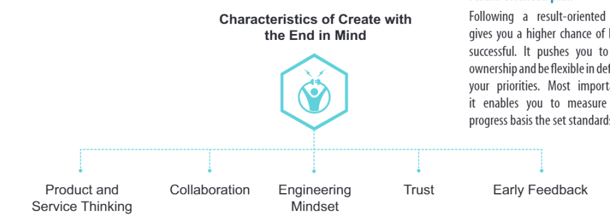
Building the DevOps Context
Notes:
Not universal and can be different for each type of test
Prevent defects: One of the objectives of software testing is to avoid mistakes throughout the development process. The cost and labor associated with error detection are considerably reduced when faults are detected early. It also saves time. Defect prevention entails conducting a root cause analysis of previously discovered flaws and then taking specific steps to prevent the recurrence of those types of faults in the future.
Evaluate work products: The objectives are used to assess work items such as the requirement document, design, and user stories. Before the developer picks it up for development, it should be confirmed. Identifying any ambiguity or contradictory requirements at this stage saves a significant amount of development and testing time.
Verify Requirements: This objective demonstrates that one of the most important aspects of testing should be to meet the needs of the client. Testers examine the product and ensure that all of the stipulated standards are met. Developing all test cases, independent of testing technique, ensures functionality confirmation for every executed test case.
Validate test objects: Testing ensures that requirements are implemented as well as that they function as expected by users. This type of testing is known as validation. It is the process of testing a product after it has been developed. Validation can be done manually or automatically.
Build confidence: One of the most important goals of software testing is to improve software quality. A lower number of flaws is associated with high-quality software.
Reduce risk: The probability of loss is sometimes referred to as risk. The goal of software testing is to lower the likelihood of the risk occurring. Each software project is unique and has a substantial number of unknowns from several viewpoints. If we do not control these uncertainties, it will impose possible hazards not only during the development phases but also during the product’s whole life cycle. As a result, the major goal of software testing is to incorporate the risk management process as early as possible in the development phase in order to identify any risks.
Share information to stakeholders: One of the most essential goals of testing is to provide stakeholders with enough information to allow them to make educated decisions, particularly on the degree of quality of the test object. The goal of testing is to offer complete information to stakeholders regarding technological or other constraints, risk factors, confusing requirements, and so on. It can take the shape of test coverage, testing reports that cover specifics such as what is missing and what went wrong. The goal is, to be honest, and ensure that stakeholders fully grasp the challenges influencing quality.
Find failures and defects: Another critical goal of software testing is to uncover all flaws in a product. The basic goal of testing is to uncover as many flaws as possible in a software product while confirming whether or not the application meets the user’s needs. Defects should be found as early in the testing cycle as feasible.

Slide 10
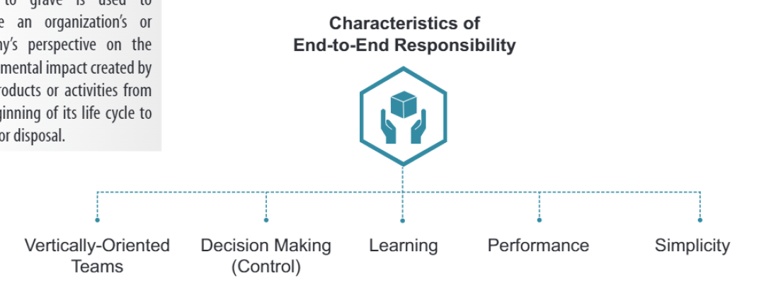
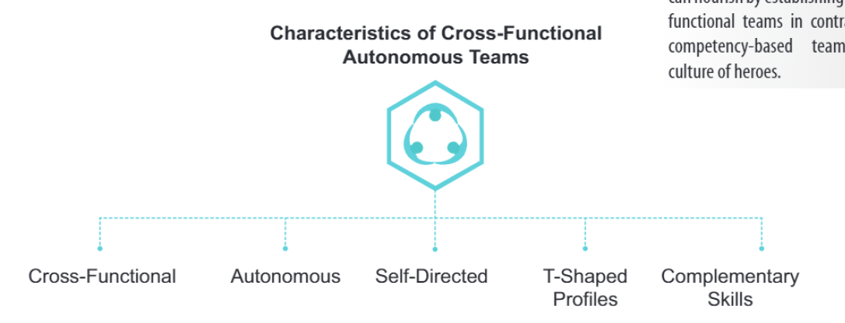
Building the DevOps Context

Slide 11
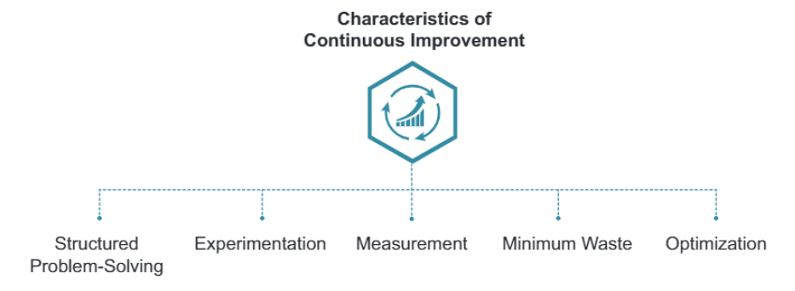
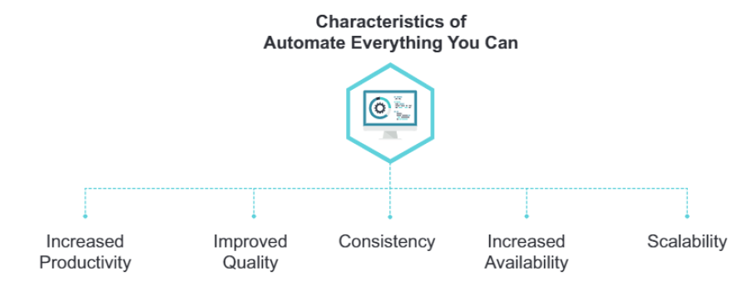
Building the DevOps Context

Slide 12
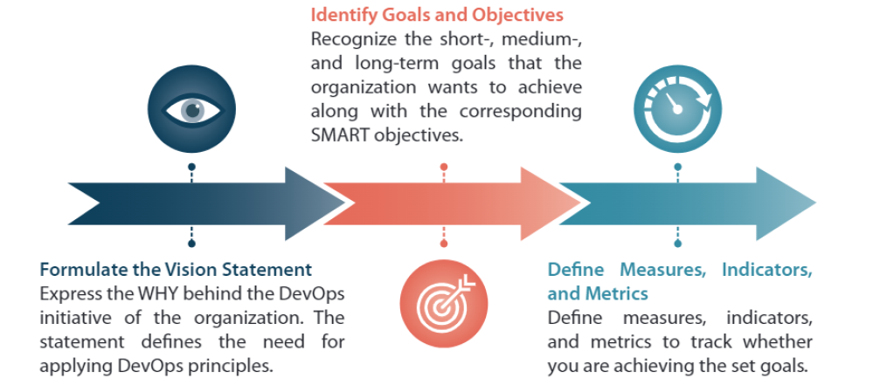
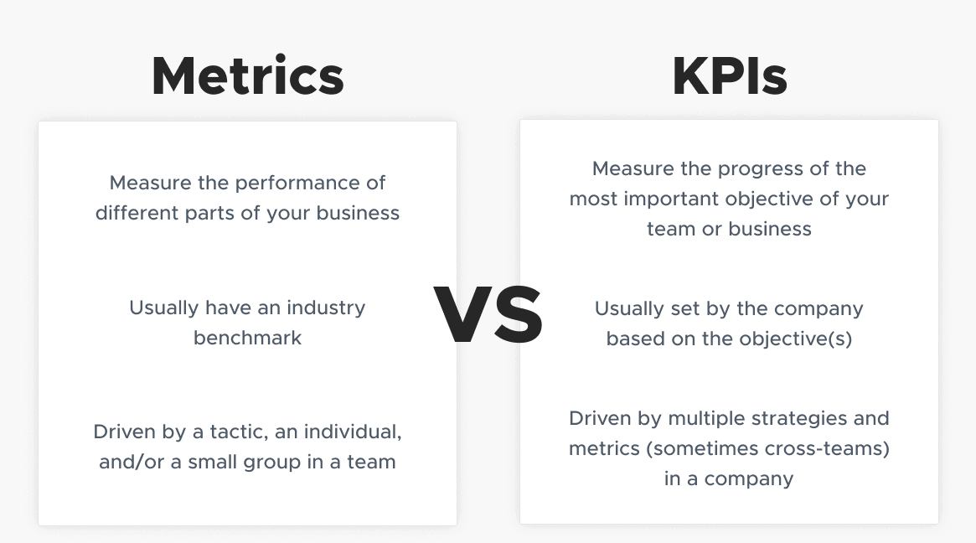
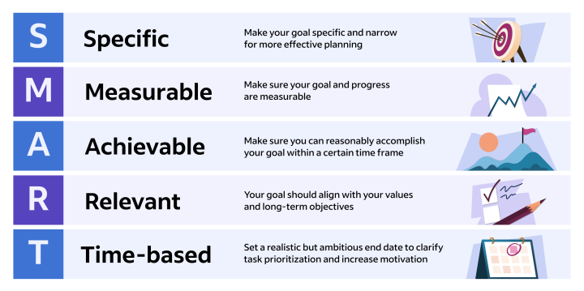
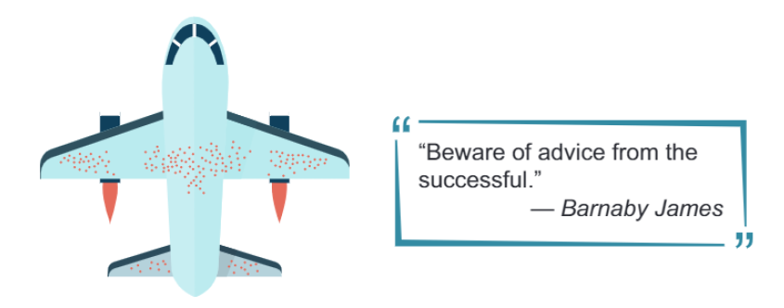
Building the DevOps Context
Notes:
Choosing the right Metrics

Slide 13
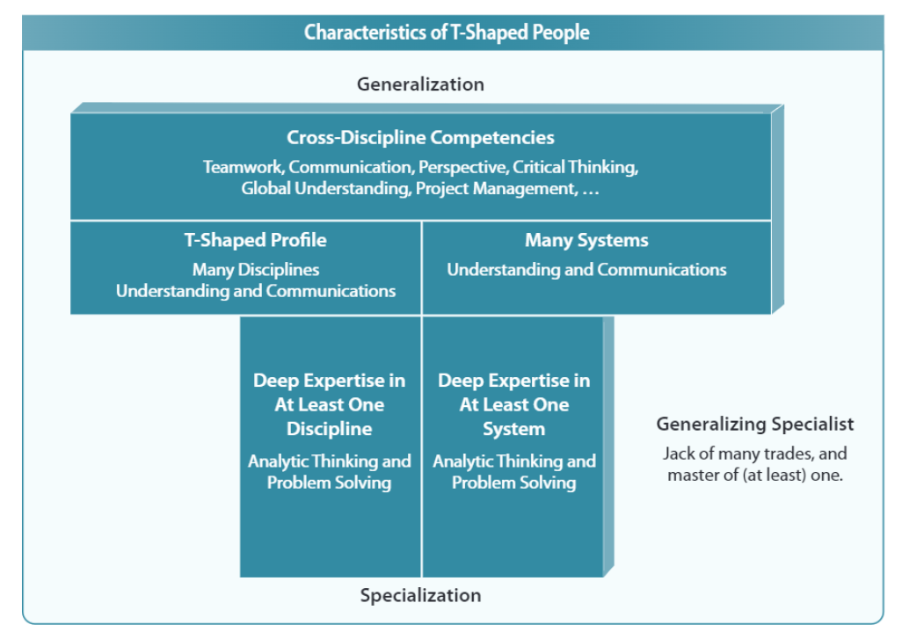
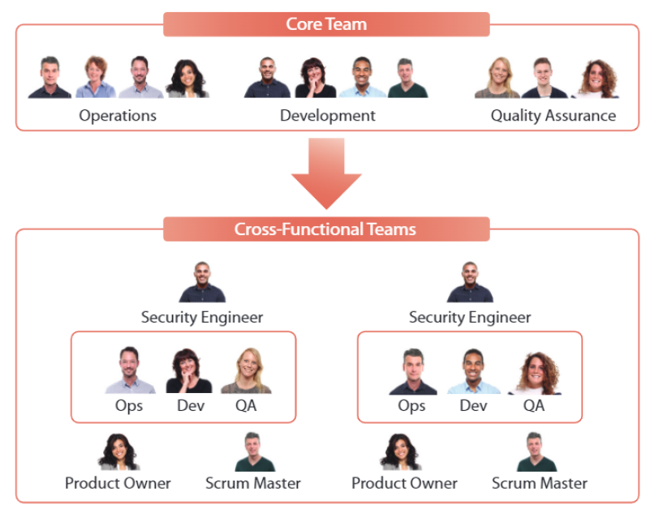
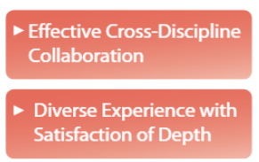
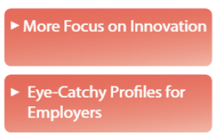
Knowing DevOps for Individuals

Slide 14
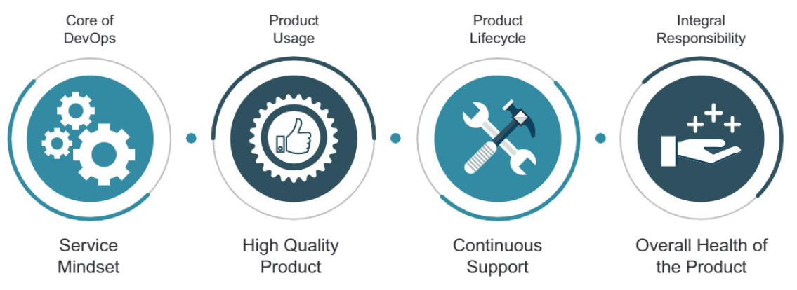
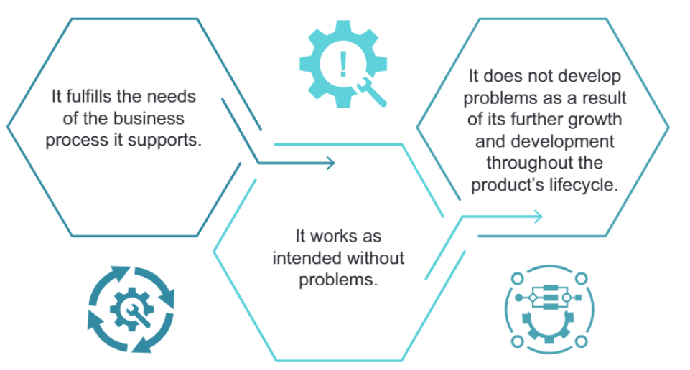
Getting acquainted with DevOps culture and behavior

Slide 15
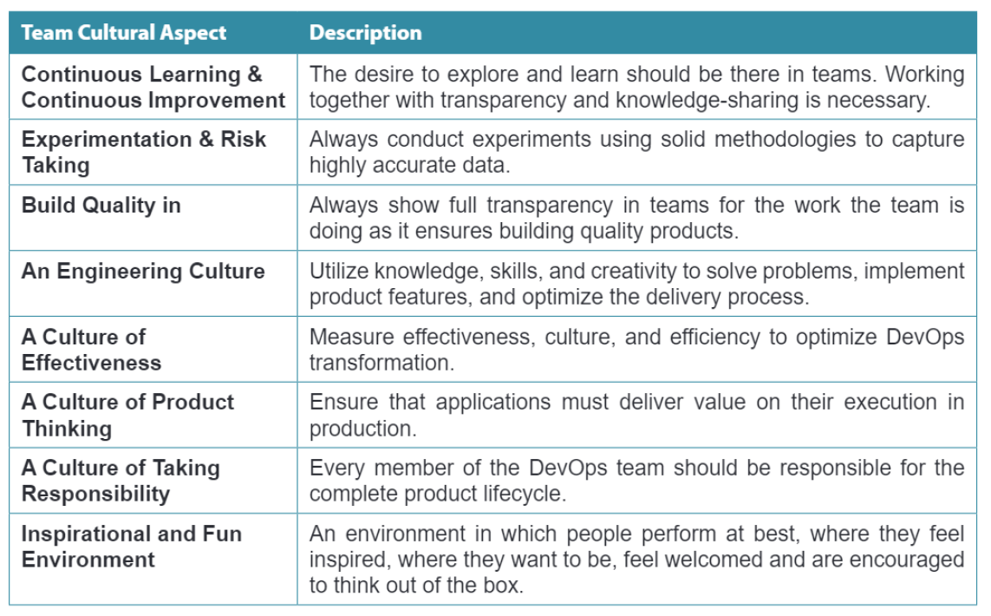
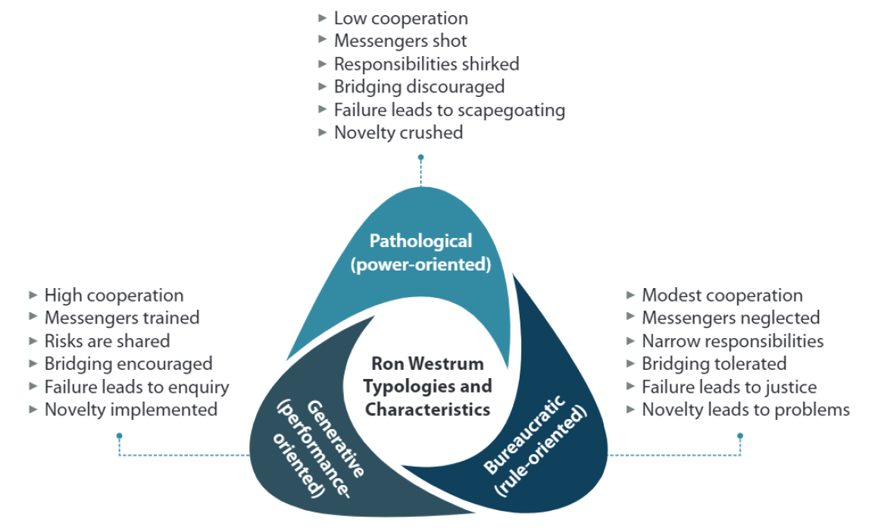
Getting acquainted with DevOps culture and behavior
Notes:
What are the causes of Errors in Software?
Here we will discuss some possible causes of these errors.
Time pressure: At times, software development happens under limited / insufficient resources with unrealistic deadlines. Developers do not have enough time to test their code before delivering it to the testing team. Which, in turn, introduces errors.
Human fallibility: Human beings are prone to make mistakes. It would be foolish to expect the software to be perfect, and without any flaws in it! Ironically, we have not yet discovered any other non-human agent that can develop software better than humans. Therefore, we continue to rely on human intelligence to develop software. Thereby, increasing the possibility of errors in it.
Inexperienced or insufficiently skilled project participants: Allocation of correct work to the correct resource is fundamental for the success of any project. Team members should be assigned a task according to their skills and abilities. An inexperienced project participant may make mistakes if they don't have proper knowledge of the work. For example, a resource having a good understanding of the database but having limited knowledge of HTML/CSS is not suitable for designing a website.
Miscommunication between project participants: Improper coordination & poor communication between various departments in a project can result in disrupted progress. Conflicts can arise each time a project participant misinterprets or misunderstands the words or actions of another. For example, the business analyst does the requirement gathering, and then some other team member does the documentation of the requirements. Any miscommunication between the two can lead to incomplete/wrong requirement document, which, in turn, affects the design of the project.
The complexity of the code, design, architecture, or the technology to be used: As the complexity of the program, concerning code, design or technology increases, the software becomes more critical and more bugs appear. It is because our brains can only deal with a reasonable amount of complexity or change. Our minds may not be able to process complex information like the form of design, architecture or technology, etc. Therefore, resulting in low quality and erroneous coding.
Misunderstandings about intra-system and inter-system interfaces: There are high chances of error while establishing an intra-system, and inter-system interfaces. Let's try to understand what is intra-system and inter-system interfaces mean:-
Intra-system interface- It implies the integration of different modules/features within a system/application. For example, in an online shopping portal, we have three modules: online order, shipping, and supply chain. These three modules form the intra-system for the online shopping portal. When these different modules are combined, there is a possibility of errors in the final product.
The inter-system interface- It is the compatibility of an application with other applications when operated together. For example, compatibility between smartphones and tablets while data transfer via Bluetooth.
New, unfamiliar technologies: Sometimes, the developers and testers need to develop an application using a technique that is unknown to them. Lack of proper knowledge and understanding can lead to errors. At that time, they require a certain level of R & D, brainstorming, and training to reach a reliable solution.
Environmental conditions: Natural disasters, such as outbreaks of fires, floods, lightning, earthquakes, etc. can affect the computers. For example, a system may not work correctly if the software inside is affected by radiation, electromagnetic, or pollution.
Enlisted below are some of the benefits, you will get:
Prevent the reoccurrence of the same problem in the future.
Eventually, reduce the number of defects reported over time.
Reduces developmental costs and saves time.
Improve the software development process and hence aiding quick delivery to market.
Improves customer satisfaction.
Boost productivity.
Find hidden problems in the system.
Aids in continuous improvement.
Troubleshooting vs. root cause analysis
RCA and troubleshooting are different processes. Troubleshooting and general problem-solving methodologies solve specific problems. For example, if an application's health monitoring reveals that a software instance crashed and is unresponsive, the team may resolve the problem by restarting the software instance or rebooting the server.
Root cause analysis for software defects, however, might reveal that the software becomes unresponsive because of a certain error condition. Perhaps the application can't access data, and the software isn't designed to handle such errors gracefully. In response, the team can release a software patch that addresses the error handling and will likely prevent the problem from recurring.

Slide 16
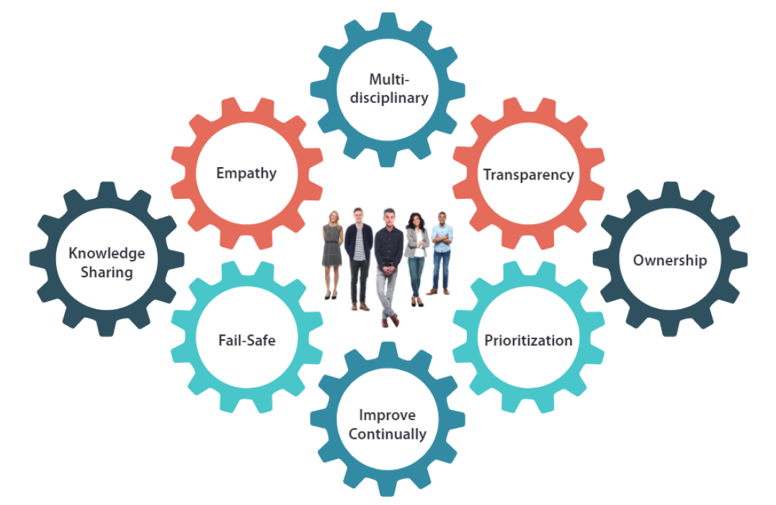
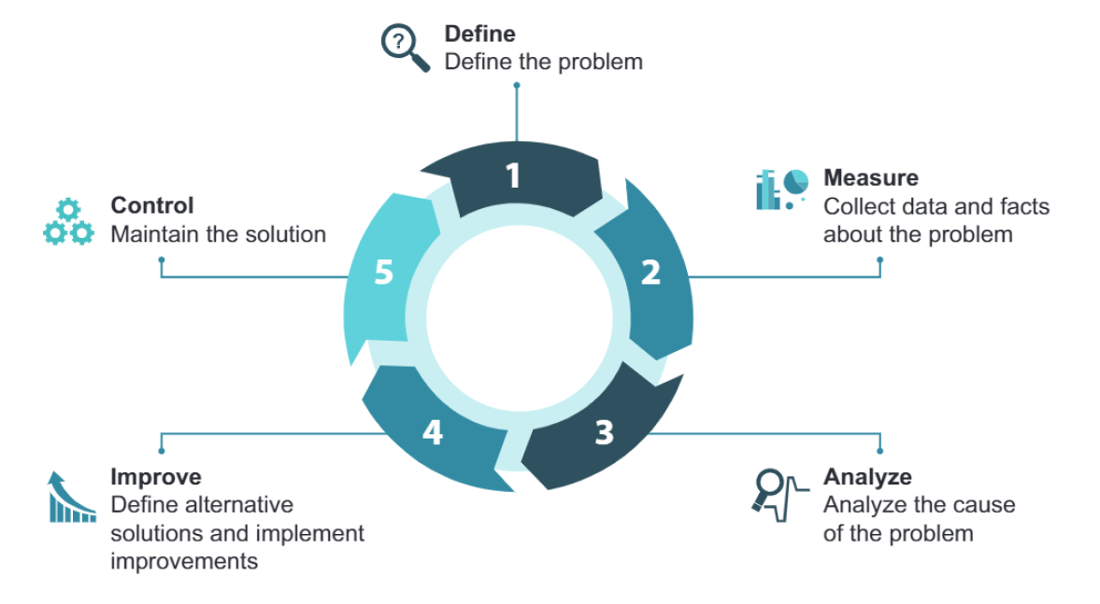
Getting acquainted with DevOps culture and behavior
Notes:
DevOps safari team collboration
Kaizen

Slide 17
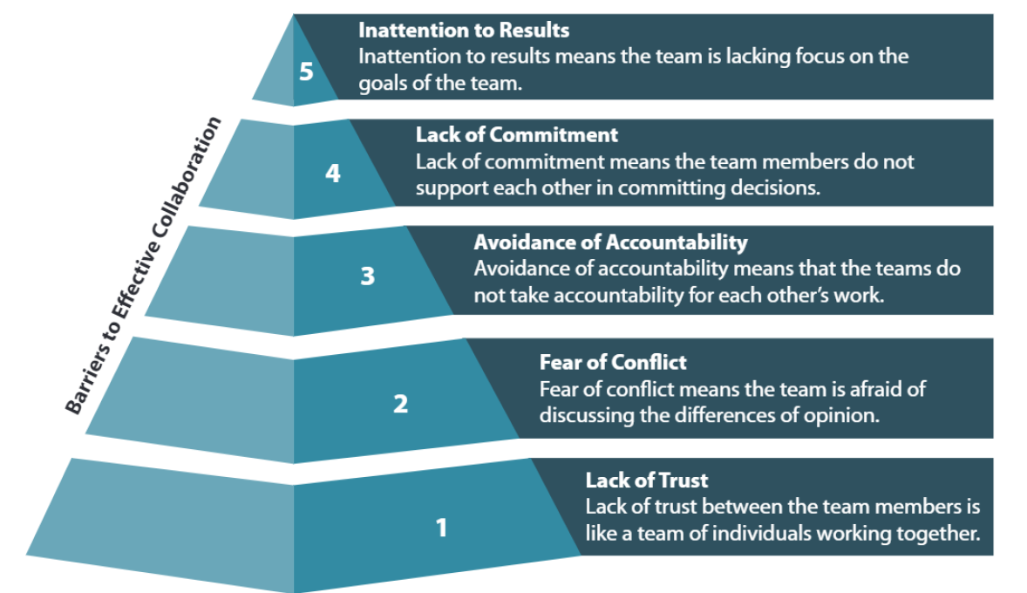
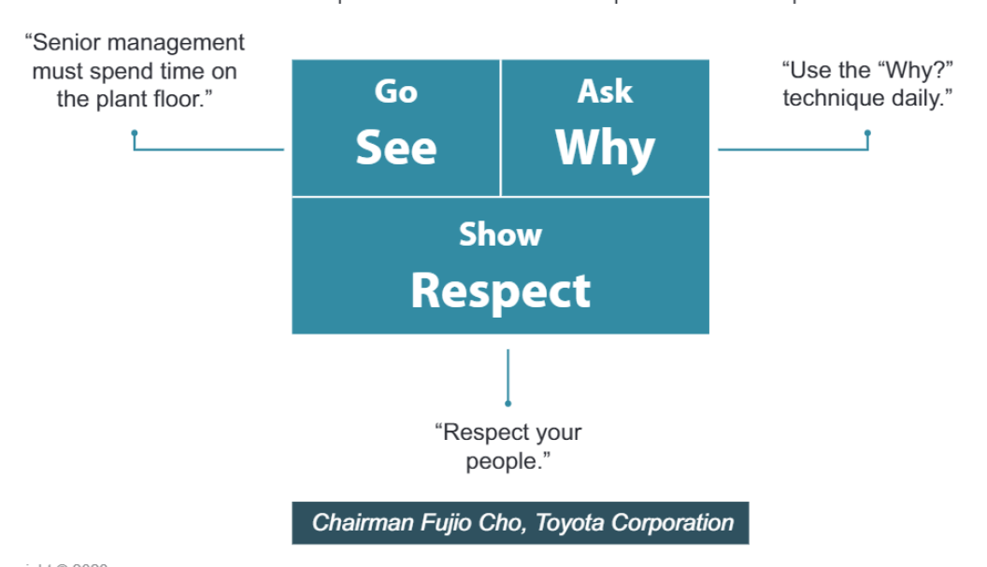
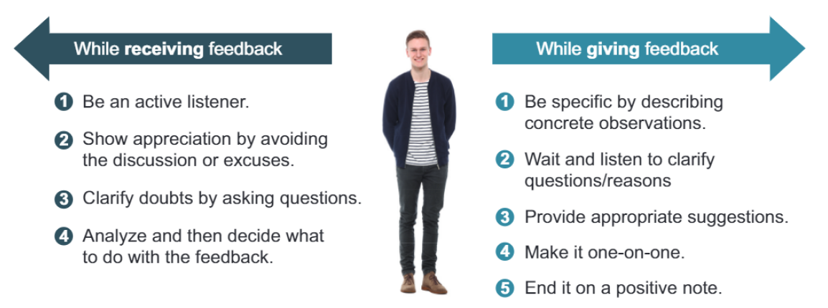
Getting acquainted with DevOps culture and behavior

Slide 18
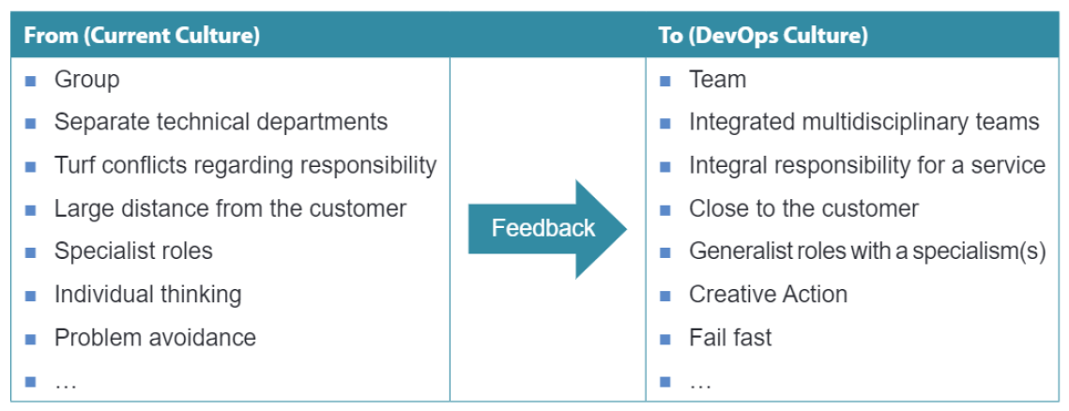
Getting acquainted with DevOps culture and behavior
Notes:
Closely related to the previous one
Some test strategy

Slide 19
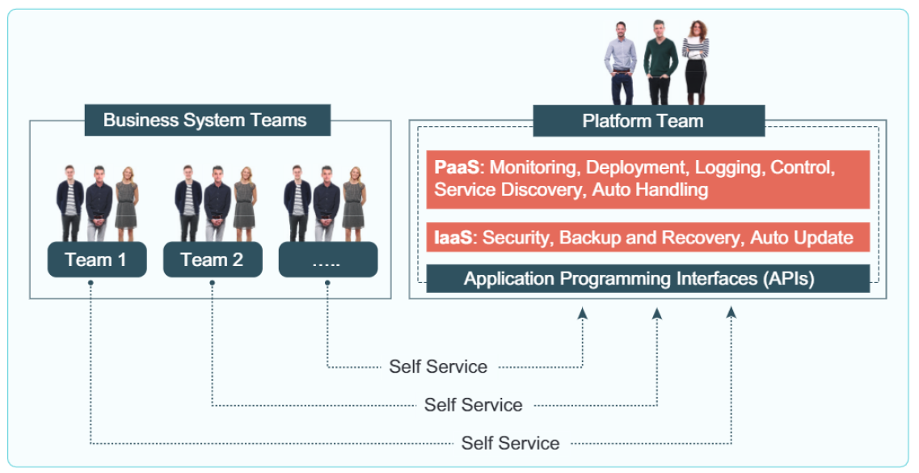
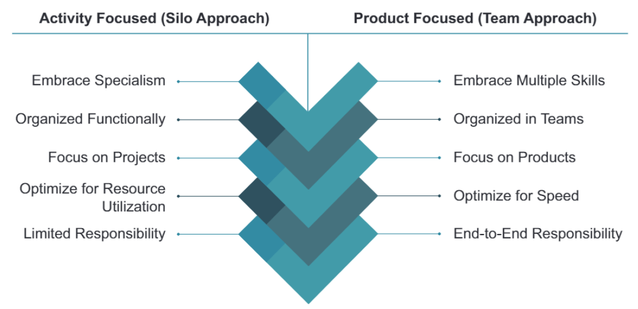
Understanding the value of DevOps for team and organizations
Notes:
Shift-left
Effort is equal fo saving time

Slide 20
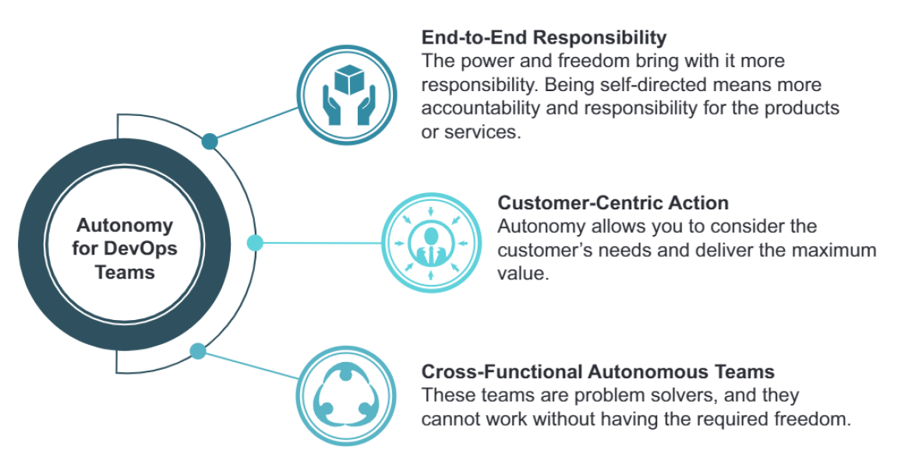
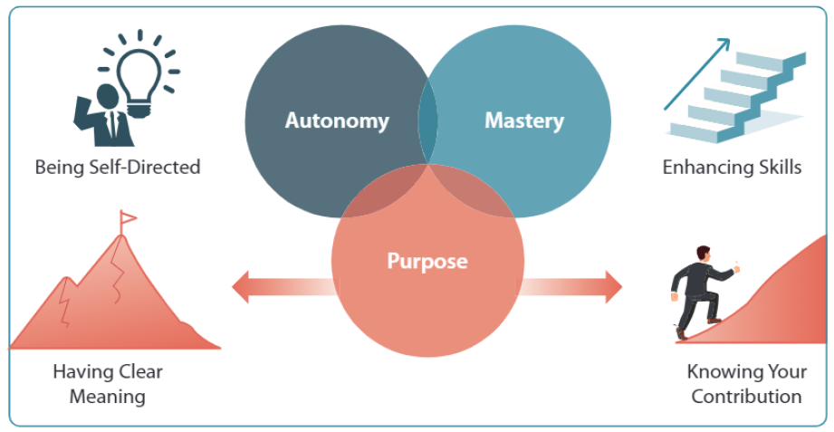
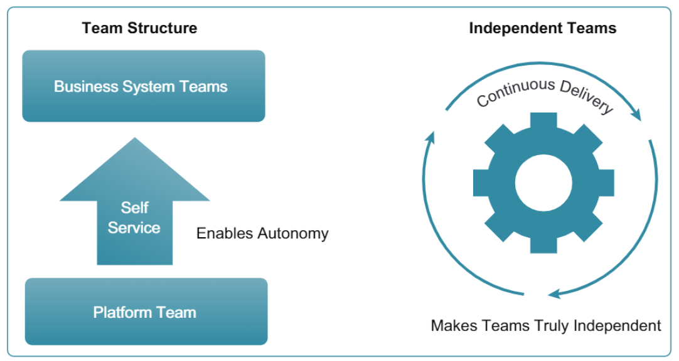

Understanding the value of DevOps for team and organizations
Notes:
Normally bug are not equally distribuited

Slide 21
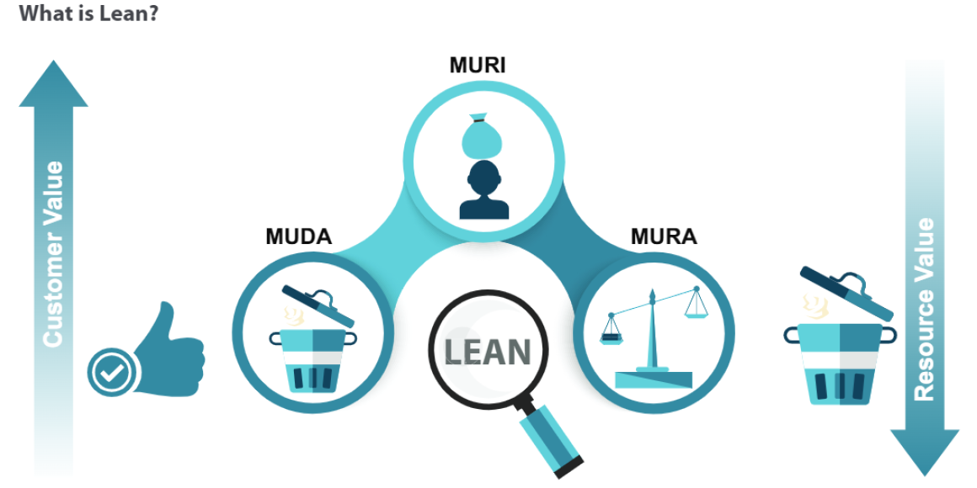
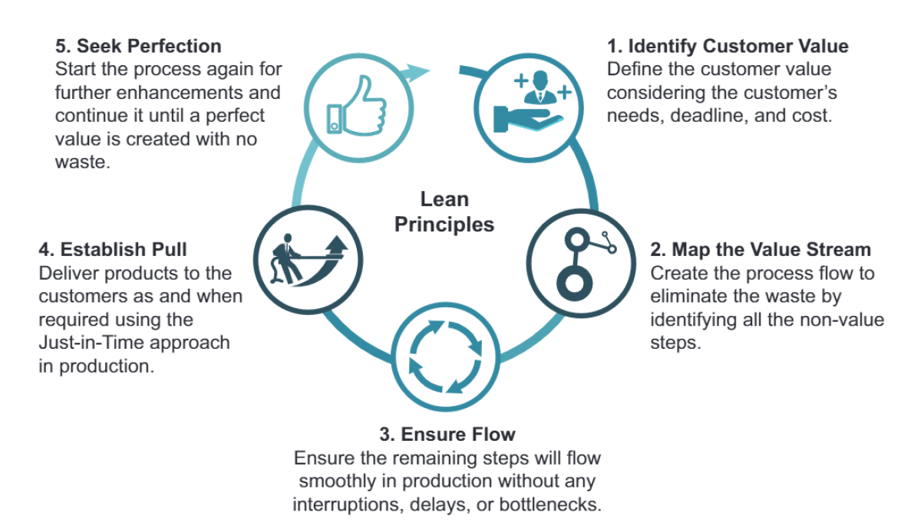
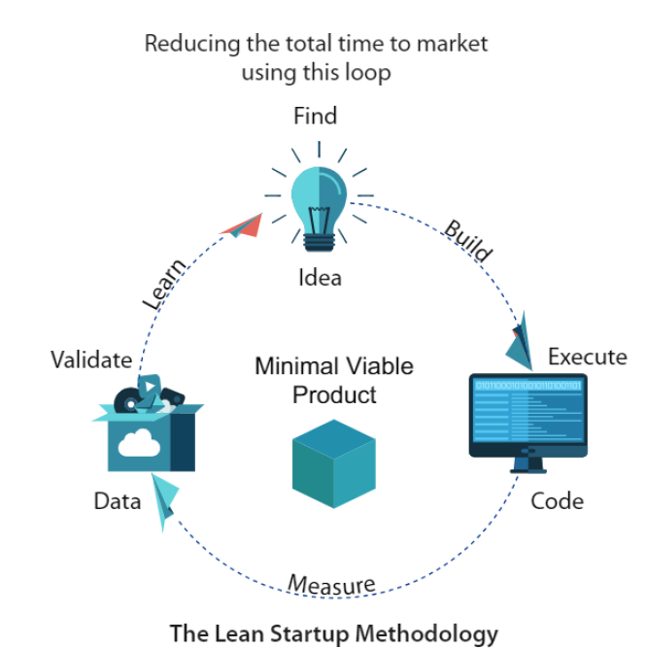
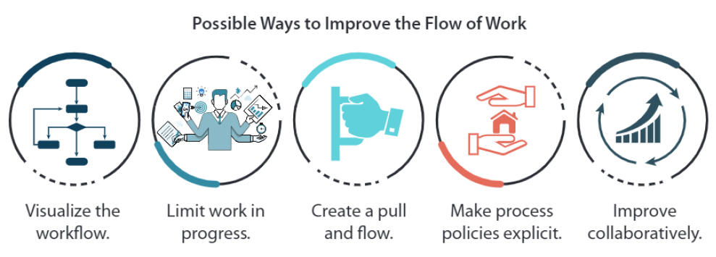
Getting familiar with DevOps management practices
Notes:
Boris Beizer discovered that using the same pesticide will kill less insect withtime the same with test you have to update
For regression test where not new bug are important to find this principle is less important

Slide 22
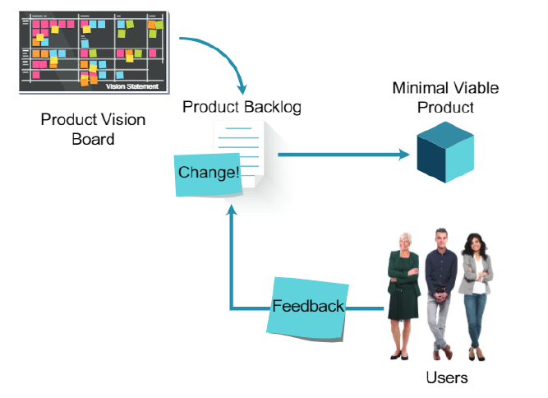
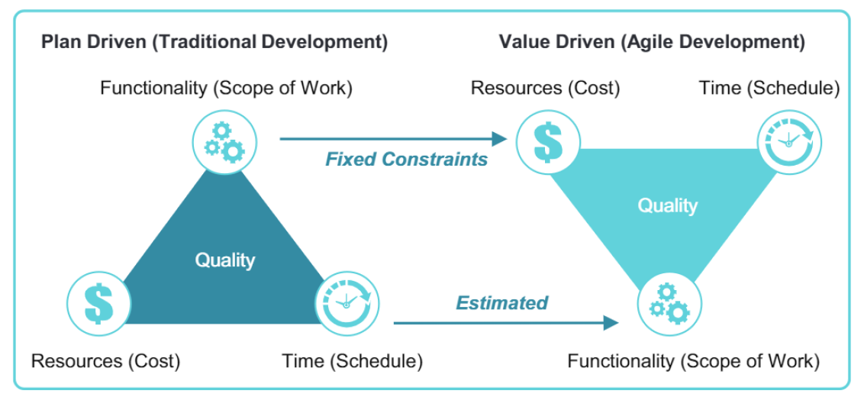
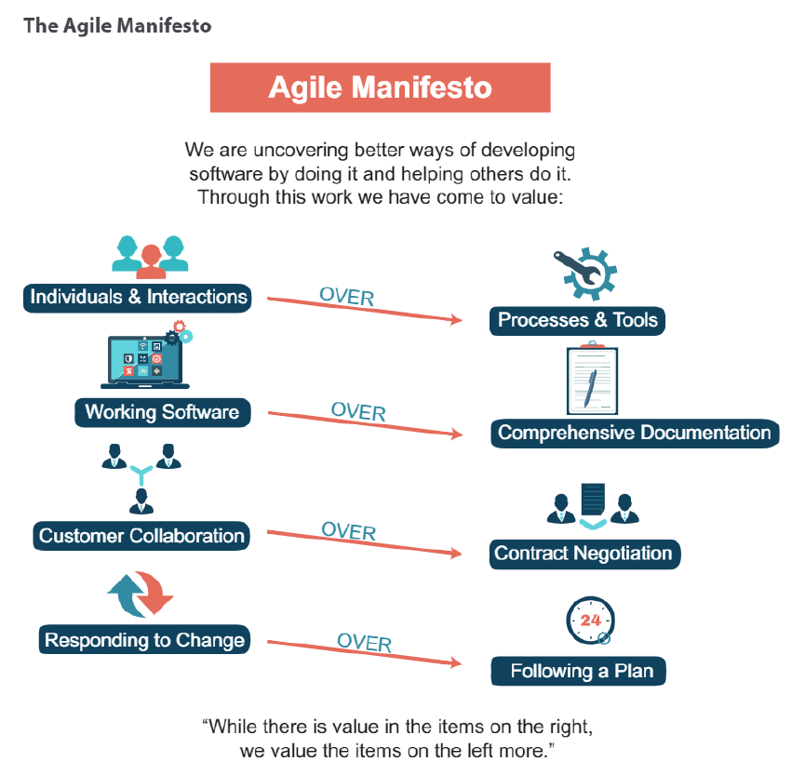
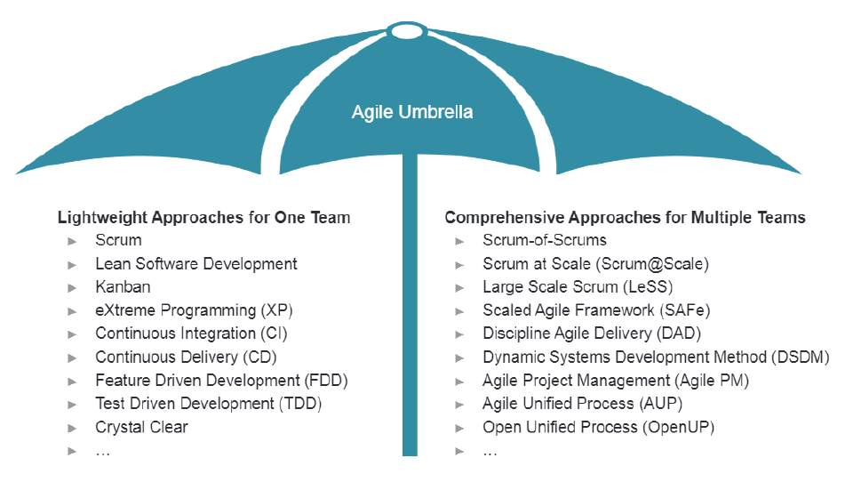
Getting familiar with DevOps management practices

Slide 23
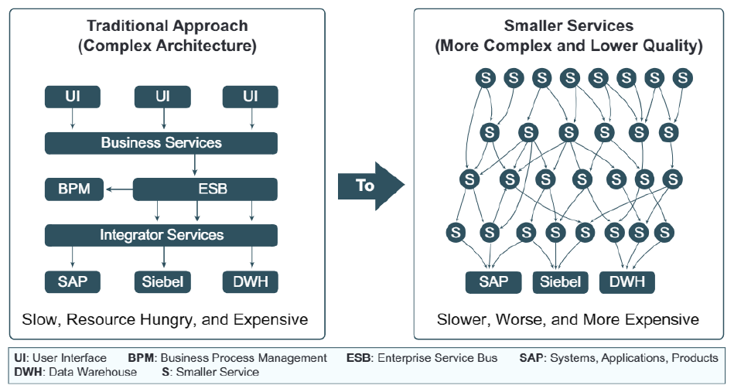
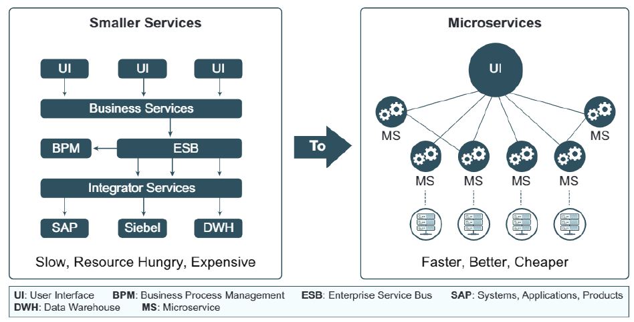
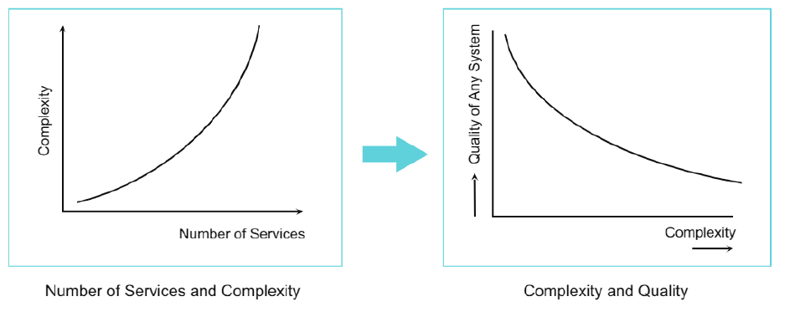
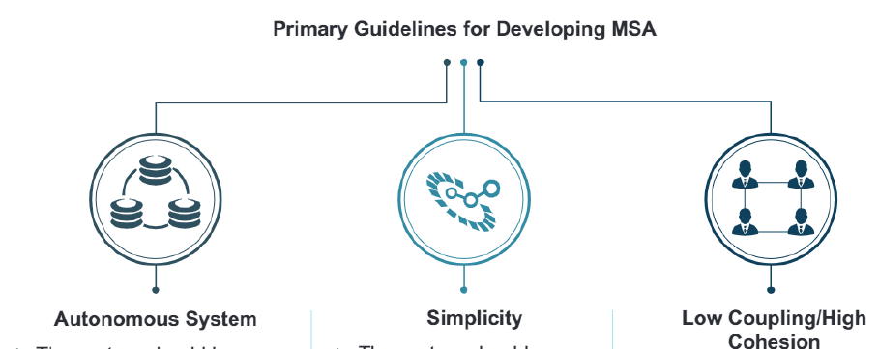
Getting familiar with DevOps technical practices
Notes:
You can have not bug and good requirement but fail on the market

Slide 24



Enabling DevOps team performance through continuous delivery and automation

Slide 25

Thank you!
Ivan Cipriani

